Slide 1
FIRST-YEAR B.TECH DDCA PROJECT
Automatic Street
Control System
A sensor-based approach to automatic street-light operation.
NAGA SAI VAISHNAVI C - 2620030490
PUJITHA - 2620030515
SIRI REDDY - 2620030562
SAI SANKEERTH - 2620030630
VAIBHAV - 2620030577
Notes:
Introduce the project as a simple automatic control system. The central idea is to sense the surrounding light and use that information to control a street light.

Slide 2
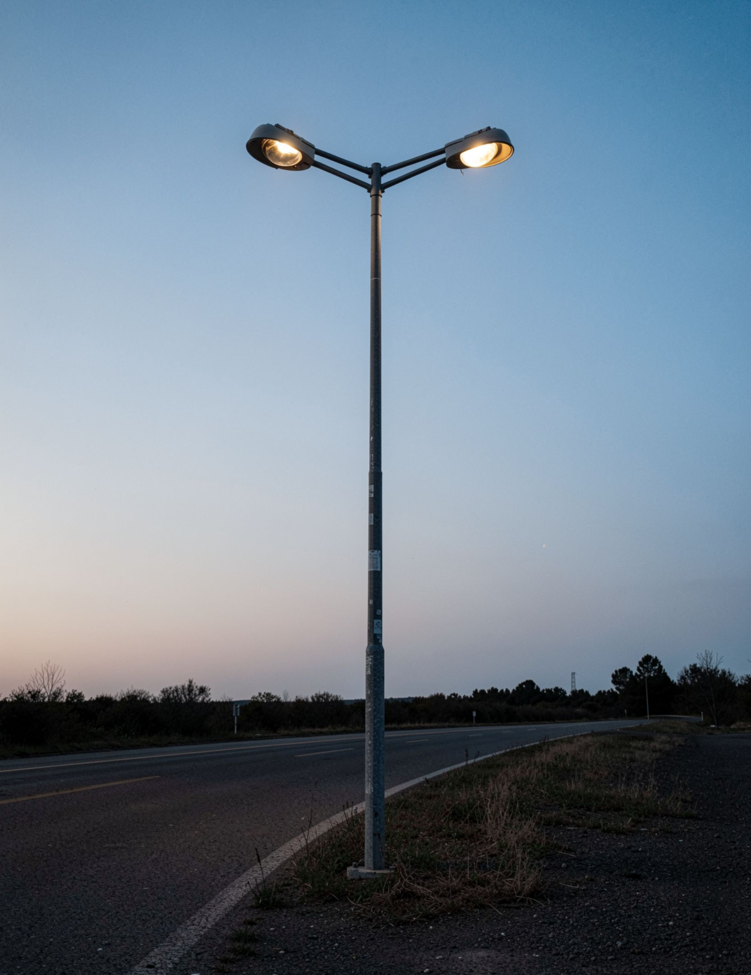
THE PROBLEM
Street lights should respond to the surroundings
Automatic control switches lights according to surrounding light intensity.
Manual switching requires human effort and regular monitoring.
Lights can remain ON during daytime and waste electricity.
A sensor-based approach reduces unnecessary operation.
This project demonstrates a simple automated lighting system.
Notes:
Begin with the everyday problem. A manually controlled street light can stay on when it is bright, or remain off when people need it. The project replaces repeated checking with a sensor-based decision.

Slide 3




SYSTEM OVERVIEW
The system combines sensing, switching, and lighting
Each part has one clear job in the control chain.
Sensing
Conditions
Switching
Lighting
LDR senses changes in surrounding light intensity.
Resistors set the circuit conditions for the decision.
A transistor or comparator controls the switching action.
An LED or lamp represents the street light load.
Power supply and wires provide energy and connections across the system.
Notes:
Describe the system from left to right. The LDR senses, the resistor network sets the condition, the switching device decides what to drive, and the LED or lamp shows the result.

Slide 4
THE SENSOR
An LDR turns brightness into an electrical decision
The sensor does not measure “day” or “night” directly. It changes resistance with light.
Condition | Light intensity | LDR resistance | System decision
Bright | High | Lower | Keep light OFF
Dark | Low | Higher | Turn light ON
The sensing circuit uses this resistance change to identify bright or dark conditions. The control circuit then switches the street light accordingly.
Notes:
Define the LDR in simple terms. More light lowers its resistance. Less light raises its resistance. The surrounding circuit converts that change into a condition that the control section can use.

Slide 5
FROM INPUT TO LOAD
The signal moves from sensor to lamp
The physical circuit has four functional sections, supported by a power supply and common ground.
01
02
03
04
LDR Sensor
Control Circuit
Switching Unit
Street Light
LDR
R1 + LDR
Q1 / U1
LED
Detects ambient light.
Turns ON or OFF.
sensor
divider
switch
Compares the sensed condition with a threshold.
Drives the load.
VCC
GND
Power supply
Common return
Example LDR divider and threshold switch. The exact threshold depends on circuit design.
Block flow: LDR Sensor → Control Circuit → Switching Unit → Street Light
Notes:
Use the left side to explain the signal path. On the right, point out the LDR and resistor divider, the threshold device, the LED load, the power supply, and ground. This is a functional example, not a claim about one fixed component choice.

Slide 6
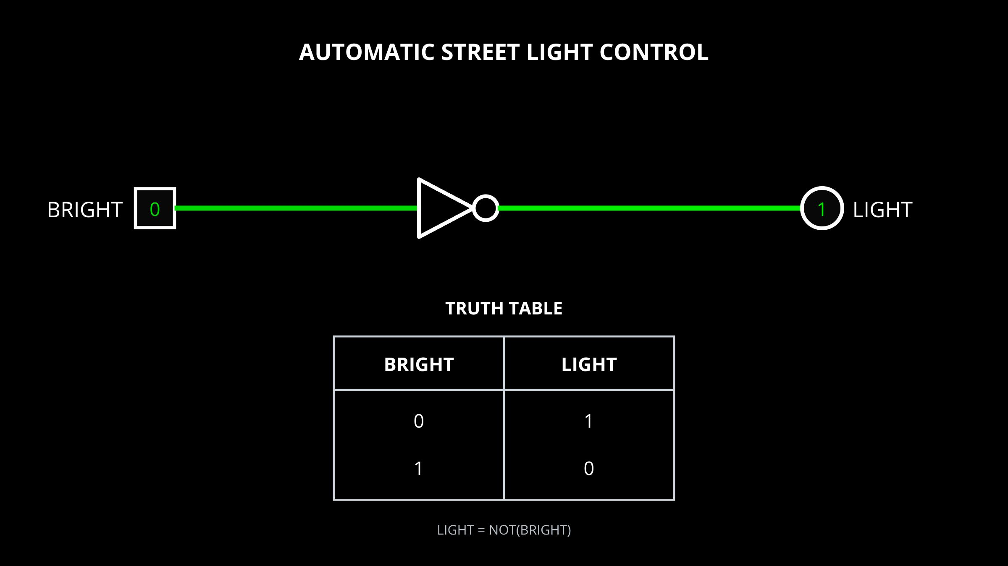
IMPLEMENTATION
Circuit diagram and implementation

Slide 7
CONTROL BEHAVIOUR
Bright means OFF; darkness means ON
The physical circuit changes continuously, but the system decision can be explained in two states.
01
02
03
04
05
Daytime
Sense
OFF
Night
ON
The LDR detects high light intensity.
The circuit identifies bright conditions.
The street light remains OFF.
The LDR detects low light intensity.
The circuit identifies darkness and turns the light ON.
The switching threshold depends on the circuit design.
Notes:
Walk through the sequence in order. In bright conditions the decision is OFF. In dark conditions the decision is ON. Emphasize that the threshold is set by the physical circuit design.

Slide 8
DIGITAL ABSTRACTION
The digital model is simply L = D
D → L
Condition | Input D | Output L
Bright | 0 | 0 (OFF)
Dark | 1 | 1 (ON)
Input D: D = 0 means bright conditions; D = 1 means darkness detected.
Output L: L = 0 means the light is OFF; L = 1 means the light is ON.
DIRECT LOGIC CONNECTION: D → L
Notes:
Separate the physical sensor from the simplified digital model. D equals zero for bright and one for dark. L equals zero for OFF and one for ON. Because the output follows the input, the Boolean expression is L equals D.

Slide 9
LOGISIM MODEL
Logisim verifies that the output follows the input
The digital model uses a binary input switch connected directly to an output LED.
01
02
03
04
Input D | Expected L | Meaning
0 | 0 | Bright: light OFF
1 | 1 | Dark: light ON
Add
Connect
Test 0
Test 1
Add a binary input switch and an output LED.
Connect the input directly to the output.
Verify input 0 gives output 0.
Verify input 1 gives output 1.
SCREENSHOT AREA
Logisim demonstrates the digital logic model. It does not directly simulate the physical LDR resistance change.
Actual Logisim simulation
Leave this space for the circuit screenshot and test-state captures.
Notes:
Explain the simulation as a verification of the logic relationship. The input switch represents D and the output LED represents L. Logisim confirms the binary mapping, but it does not model the analog resistance behaviour of the real LDR.

Slide 10
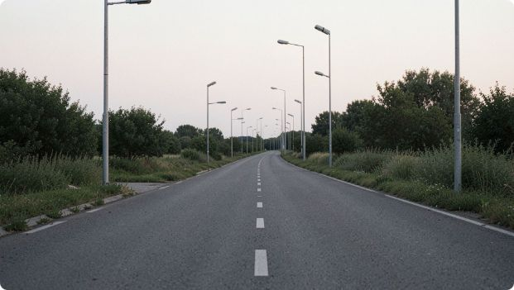
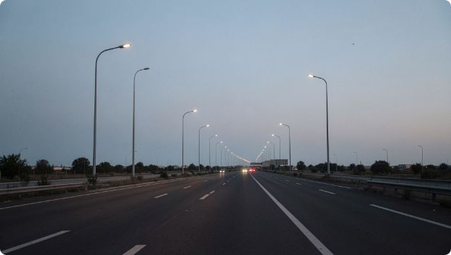

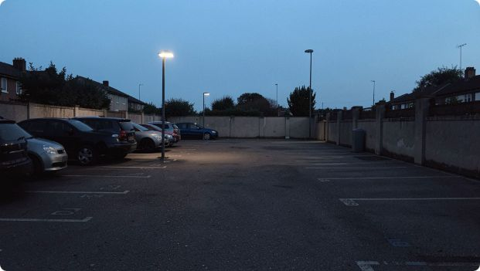
APPLICATIONS
Simple automation can scale to real spaces
The same sensing-and-switching idea can support many lighting environments.
Roads
Highways
Campuses
Parking areas
Automatic operation reduces manual effort and unnecessary daytime lighting.
The design can support lighting over longer routes.
Lighting can respond without constant monitoring.
Additional sensors can extend the system for smart-city lighting.
A simple control mechanism supports more efficient street-light operation across roads, highways, campuses, parking areas, residential streets, and smart-city lighting.
Notes:
Connect the classroom model to real spaces. The system demonstrates a simple control mechanism that reduces manual effort and avoids unnecessary daytime lighting. More sensors can extend the same idea.

Slide 11
TAKEAWAY
Automatic control is a foundation for smarter lighting
The LDR senses ambient conditions and informs the control circuit.
The system demonstrates sensor-based automation and basic digital logic.
Automatic control can reduce unnecessary lighting and manual effort.
FUTURE SCOPE
Solar-powered street lights.
Motion sensors, IoT remote monitoring, and automatic brightness adjustment.
Thank You
Notes:
Close by returning to the complete chain: sensing, control, switching, and lighting. The project is a foundation. Future versions can add solar power, motion sensing, remote monitoring, and automatic brightness adjustment.

